Slide 1
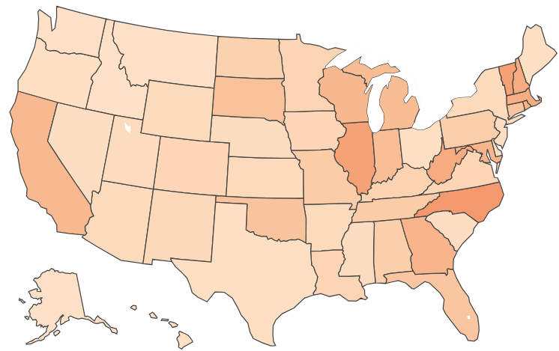
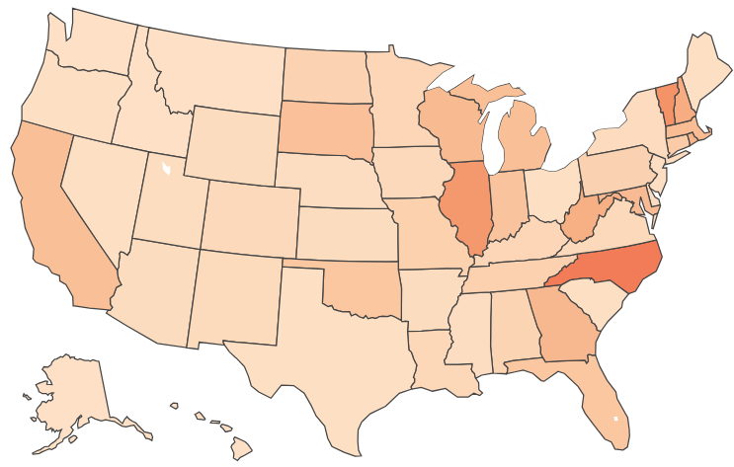
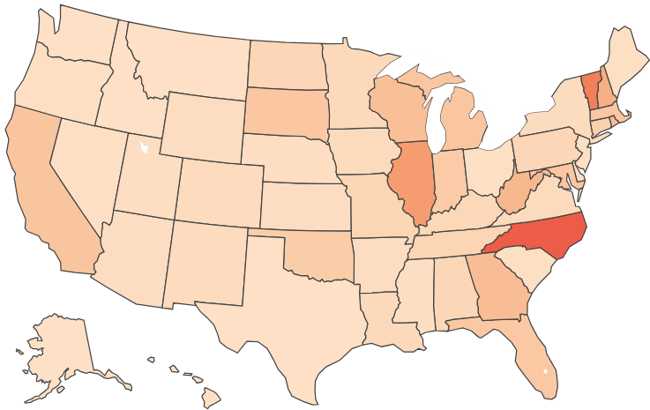
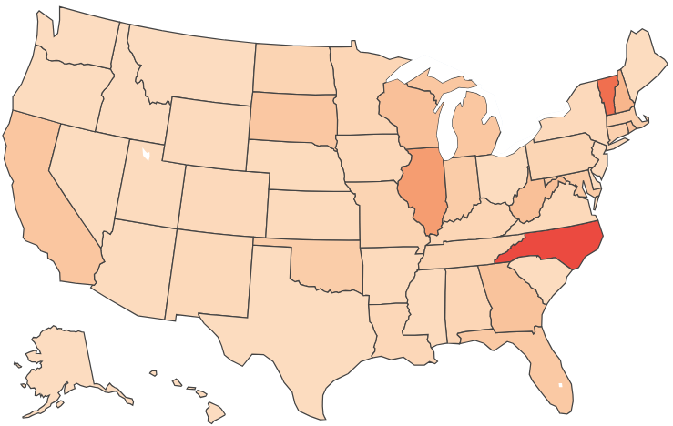
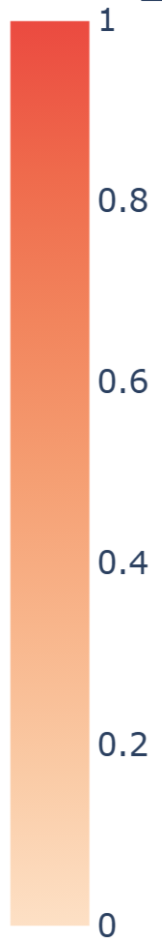
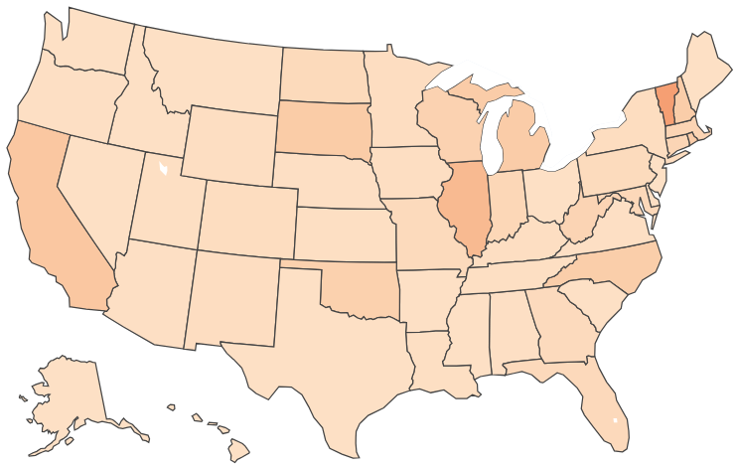
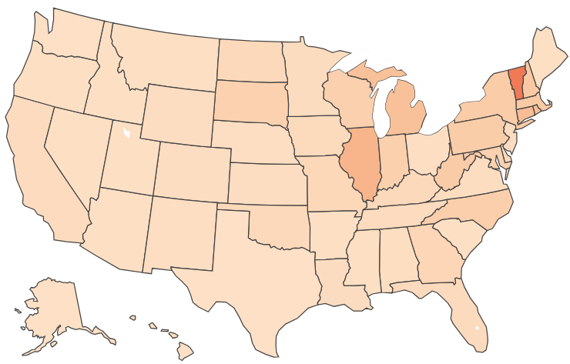
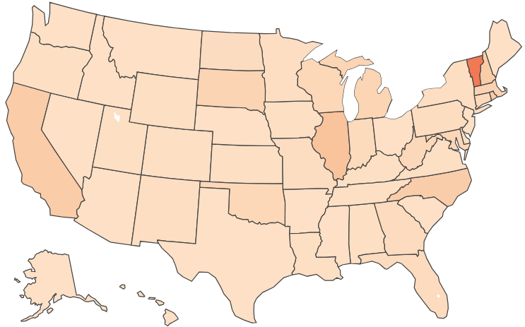
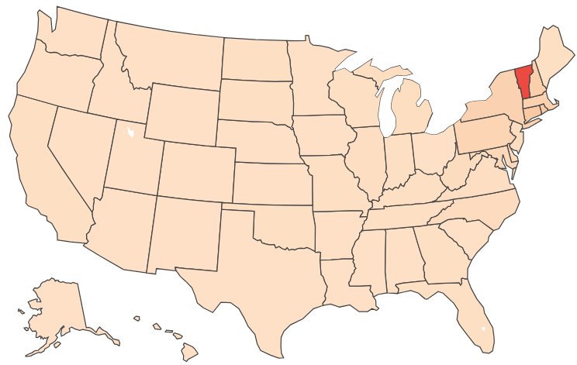
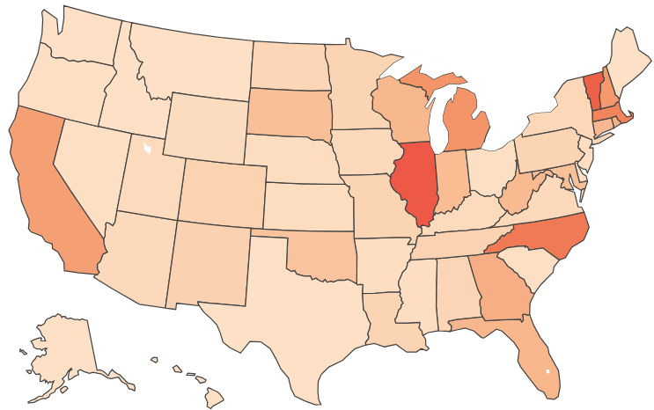
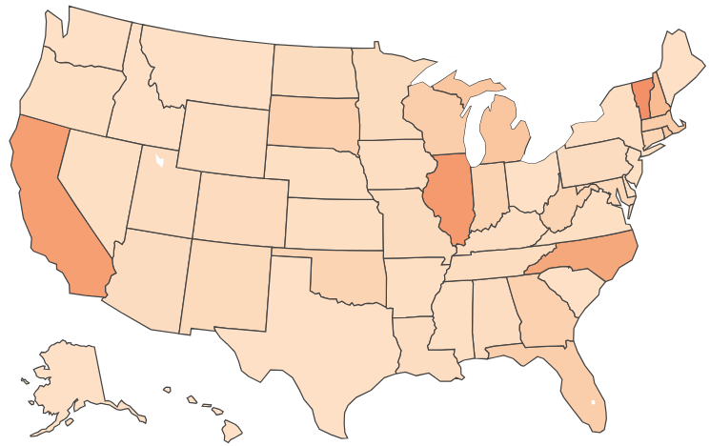
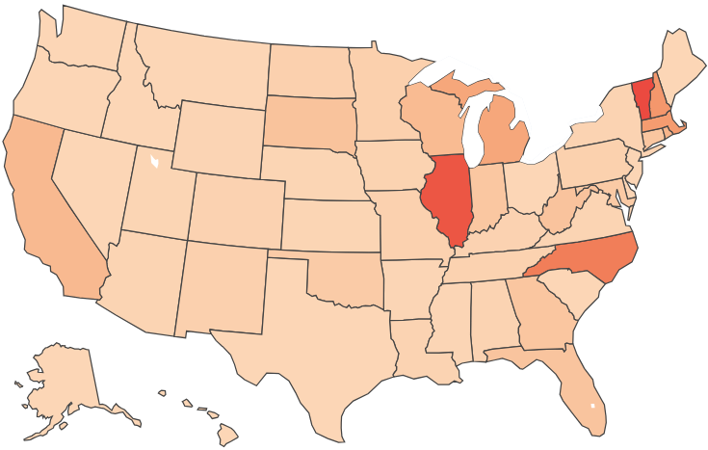
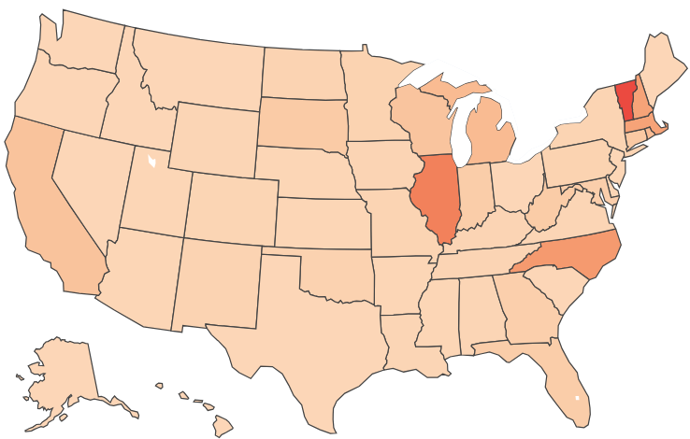
 | α=0.5, γ=2 | α=1, γ=2 | α=1.5, γ=2 | α=2, γ=2
03/20/2020–04/15/2020
05/15/2020–06/15/2020
08/15/2020–09/15/2020

Slide 2
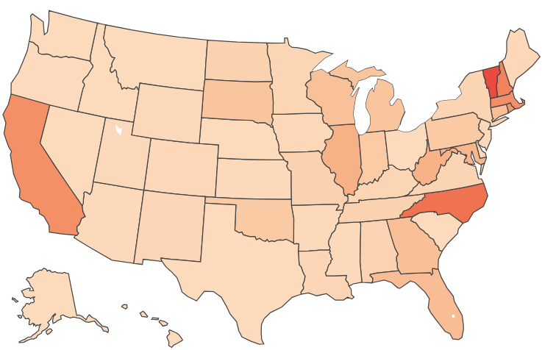
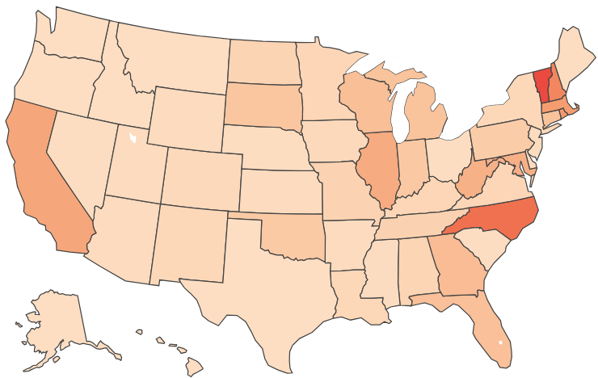
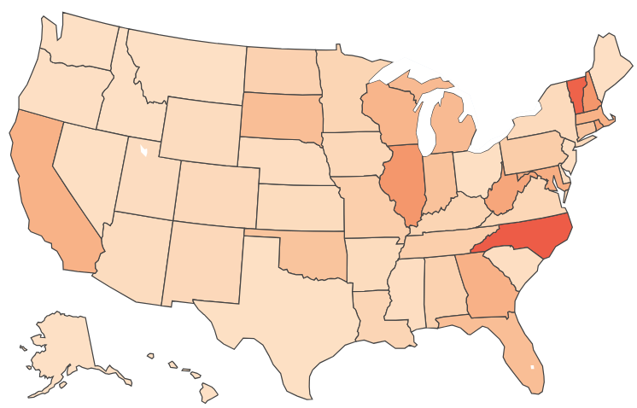
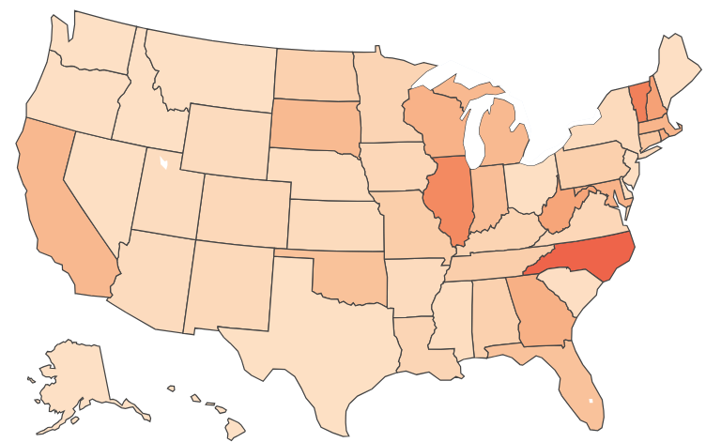
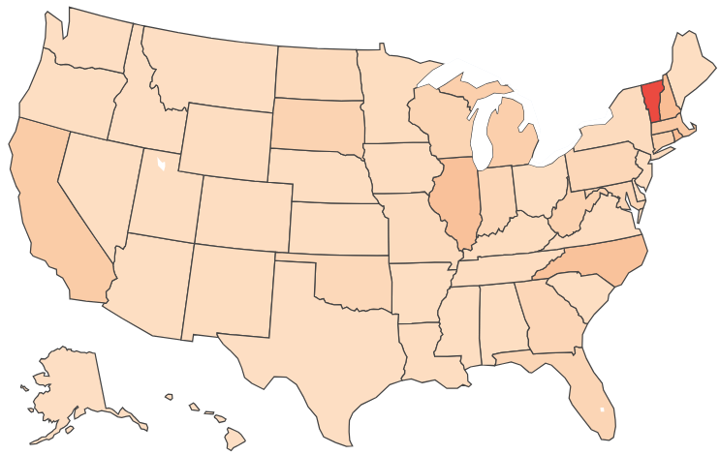
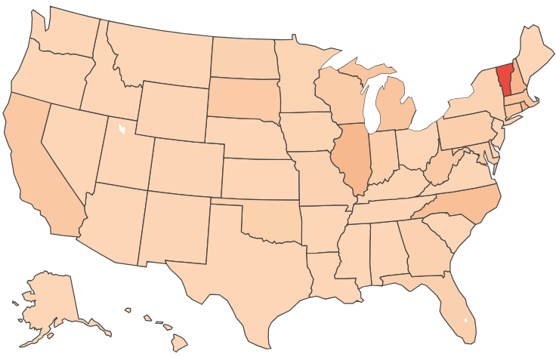

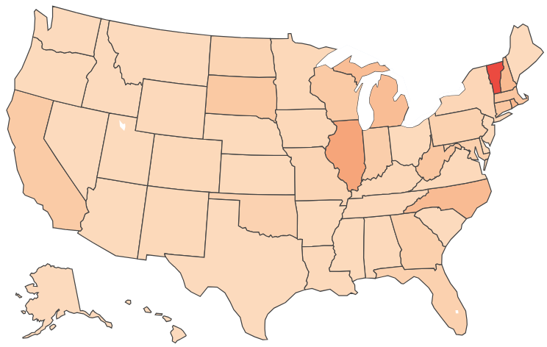
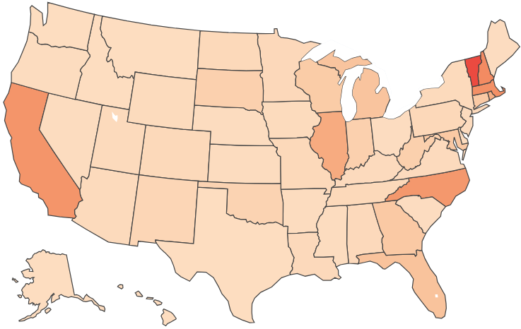

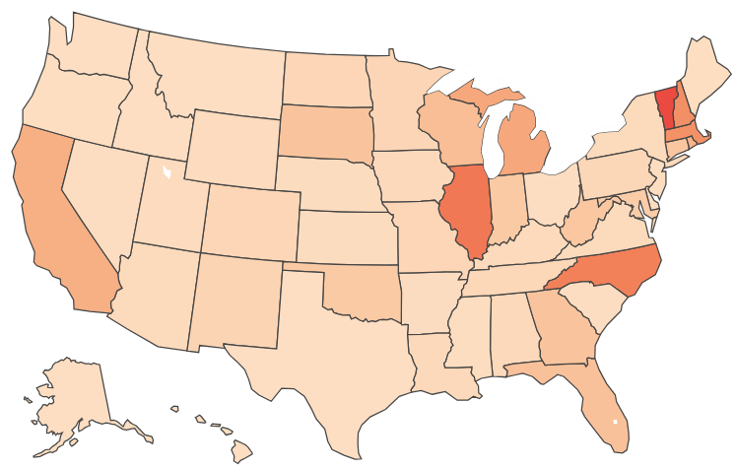
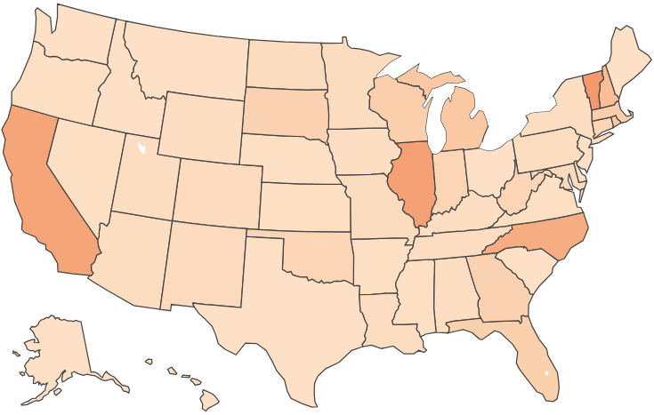
 | α=1, γ=0.5 | α=1, γ=1 | α=1, γ=1.5 | α=1, γ=2
03/20/2020–04/15/2020
05/15/2020–06/15/2020
08/15/2020–09/15/2020

Slide 3
 | Alpha=0.5,Gamma=2 | Alpha=1,Gamma=2 | Alpha=1.5,Gamma=2 | Alpha=2,Gamma=2
April~May | North Carolina | North Carolina | North Carolina | North Carolina
May~June | Oklahoma | New York | New York | New York
June~July | Vermont | Vermont | Oklahoma | Florida
July~August | New York | New York | California | Massachusetts
August~September | New Jersey | Connecticut | Connecticut | Connecticut

Slide 4
 | Alpha=0.5,Gamma=2 | Alpha=1,Gamma=2 | Alpha=1.5,Gamma=2 | Alpha=2,Gamma=2
April~May | New York | New York | New York | Vermont
May~June | California | California | Illinois | California
June~July | Illinois | Illinois | Massachusetts | Illinois
July~August | California | North Carolina | Illinois | Illinois
August~September | Massachusetts | California | North Carolina | North Carolina

Slide 5
 | α = 0.5, γ = 2 | α = 1, γ = 2 | α = 1.5, γ = 2 | α = 2, γ = 2
03/20/2020–04/15/2020 | (0.0924, 0.0784) | (0.0842, 0.0868) | (0.0746, 0.0952) | (0.0678, 0.103)
05/15/2020–06/15/2020 | (0.0384, 0.0410) | (0.0457, 0.0688) | (0.0318, 0.0552) | (0.0239, 0.0813)
08/15/2020–09/15/2020 | (0.107, 0.100) | (0.0459, 0.0506) | (0.0729, 0.104) | (0.0520, 0.0861)

Slide 6
 | α = 1, γ = 0.5 | α = 1, γ = 1 | α = 1, γ = 1.5 | α = 1, γ = 2
03/20/2020–04/15/2020 | (0.0835, 0.103) | (0.0816, 0.0973) | (0.0869, 0.0937) | (0.0842, 0.0868)
05/15/2020–06/15/2020 | (0.0359, 0.0618) | (0.0378, 0.0678) | (0.0396, 0.0655) | (0.0457, 0.0688)
08/15/2020–09/15/2020 | (0.0703, 0.0943) | (0.0830, 0.108) | (0.0880, 0.104) | (0.0459, 0.0506)

